Slide 1
MIERUCA TEAM MTG
2017.4.4
© Faber Company, Inc. All Rights Reserved. | Confidential

Slide 2
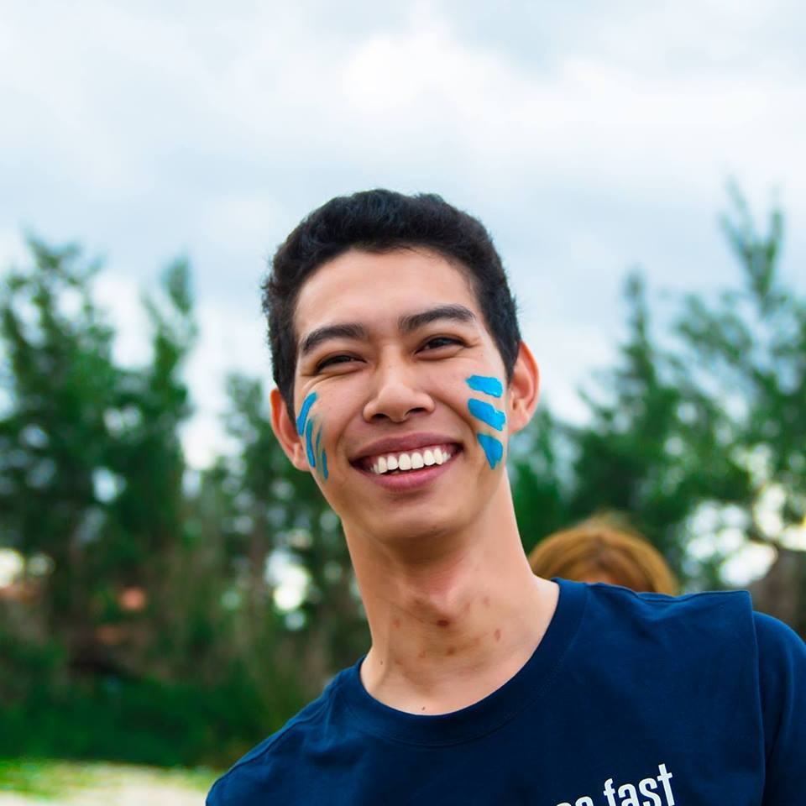
Self-introduction
Name: Nguyễn Viết Diêm
Facebook: https://www.facebook.com/MrHit3010
Introduce yourself:
Your strength: Frontend Developer.
Your history: 1,5 year experience in Haravan (Programming language: shopyfi). 3 month Innotech (Outsource).

Slide 3
What is our role for in the future

